Slide 1

WIRELESS
COMMUNICATION
Energy-Aware Online Positioning of UAV Base Stations in Dynamic Networks
Nikhil 112316031
Visweswar 112316009
Vinit 112316010
Sangamesh 112316041
Bhavya 112316012

Slide 2
PROBLEM STATEMENT
When a terrestrial base station fails, communication is lost, and drone-mounted base stations are dynamically deployed to fill the coverage gap. However, current algorithms designed to position these drones focus solely on maximizing network capacity, causing the drone to constantly move to chase the best possible signal. This continuous movement is highly inefficient because it ignores the significant energy costs associated with flying. Therefore, a new approach is needed that balances network performance with movement costs, ensuring the drone only relocates when the communication improvement justifies the energy spent.

Slide 3
BASIC TERMINOLOGY & BACKGROUND
Coverage Hole: Area where users receive no or insufficient signal, typically caused by a site failure
Aerial Base Station (Aerial-BS): A base station mounted on a UAV, offering a flexible and agile alternative to fixed terrestrial infrastructure.
Traffic Hotspots: Sudden surges in network demand caused by large crowds (festivals, sports events) or displaced populations during emergencies.
Cell Individual Offset (CIO): Bias in cell selection used to shift users between cells →Helps balance load

Slide 4
BASIC TERMINOLOGY & BACKGROUND
QoS (Quality of Service): A measure of the overall performance of the network, often quantified by throughput, signal strength, or call success.
CSR (Call Success Rate): The fraction of initiated calls that successfully maintain a connection and meet minimum bit rate requirements. Main performance metric used in the paper
Air-to-Ground (A2G) Channel: The wireless link between the UAV and ground users, characterized by a higher probability of Line-of-Sight (LoS) compared to terrestrial links.
Online Positioning: A real-time approach where the UAV moves and adapts its position dynamically based on live measurements rather than pre-planned coordinates.

Slide 5

OBJECTIVE OF THE RESEARCH PROBLEM
The Core Challenge: Positioning for Performance
The Core Challenge: Positioning for Performance
The Deployment Trade-off: Determining the optimal 3D position (x, y, z) is difficult because it depends on unknown factors like user distribution and local propagation environments.
Dynamic Adaptation: Since users move (User Mobility), the UAV must be able to track the "optimal" position in real-time without manual reconfiguration.
Capacity vs. Coverage: UAVs must decide whether to move toward a traffic hotspot to provide capacity relief or stay near a site failure to patch a coverage hole.

Slide 6
OBJECTIVE OF THE RESEARCH PROBLEM
The Shift Toward Energy-Awareness
Data-Driven Online Algorithm: Develop a real-time algorithm to optimize the position of a drone-mounted base station during network disruptions.
Continuous Adaptation: Dynamically adjust to a changing environment, including variations in user distribution and moving traffic hotspots.
Real-Time Metrics: Utilize practically measurable network data (like cell load) instead of relying on prior environmental knowledge or pre-deployment training.
Performance Optimization: Achieve near-optimal Call Success Rate (CSR) to maximize the fraction of successful connections in dynamic scenarios.

Slide 7
SIMULATION AND RESULTS

Slide 8
MODELING ASSUMPTIONS
Network: 12 sites, 3 sectors each (36 cells), hexagonal layout with wraparound
Environments: Urban (500 m ISD, capacity-limited) & Rural (3500 m ISD, coverage-limited)
Antenna Model: Directional BS antennas; drone uses simplified antenna with lower transmit power
Propagation:Separate models for BS–UE and Drone–UE links
Includes LoS/NLoS conditions
Uses environment parameters (α, β, γ)
Shadow fading and minimum coupling loss considered
Traffic: Random user arrivals with a traffic hotspot (higher load region)
Static users, fixed minimum data rate
Resource Management:
User connects to best signal (with bias)
Admission control + fair scheduling
Handover and call drop conditions included
Performance Metric: Call Success Rate (CSR)

Slide 9
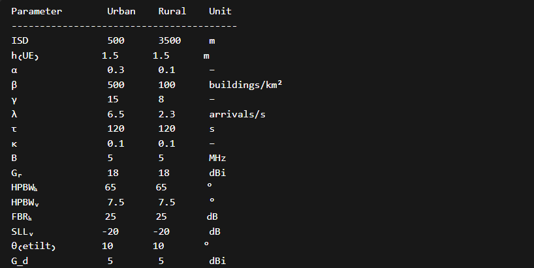
SIMULATION PARAMETERES

Slide 10
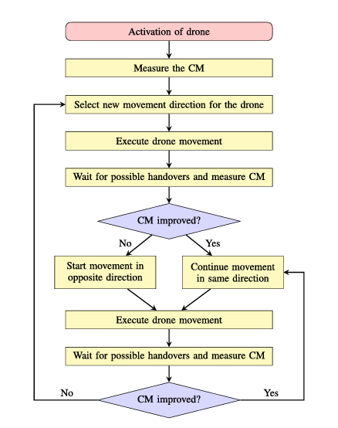
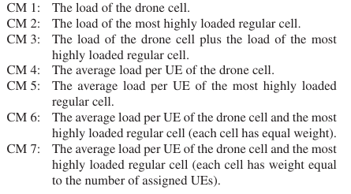
ALGORITHM

Slide 11
SIMULATION ASSUMPTIONS
The drone’s altitude is fixed at 120 m and the Cell Individual Offset (CIO) is set to 0 dB, based on insights from the base paper indicating minimal impact on overall performance.
Simulations were conducted for a duration of 90 minutes, averaged over 4 independent runs, compared to the 4-hour simulation window used in the base study.
To compensate for the shorter simulation duration and to ensure system robustness, higher user arrival rates were considered in both urban and rural scenarios.
Due to these modified simulation conditions, the obtained results show slight quantitative deviations from the base paper.
However, the results continue to demonstrate consistent performance trends, validating the effectiveness of the proposed approach.

Slide 12
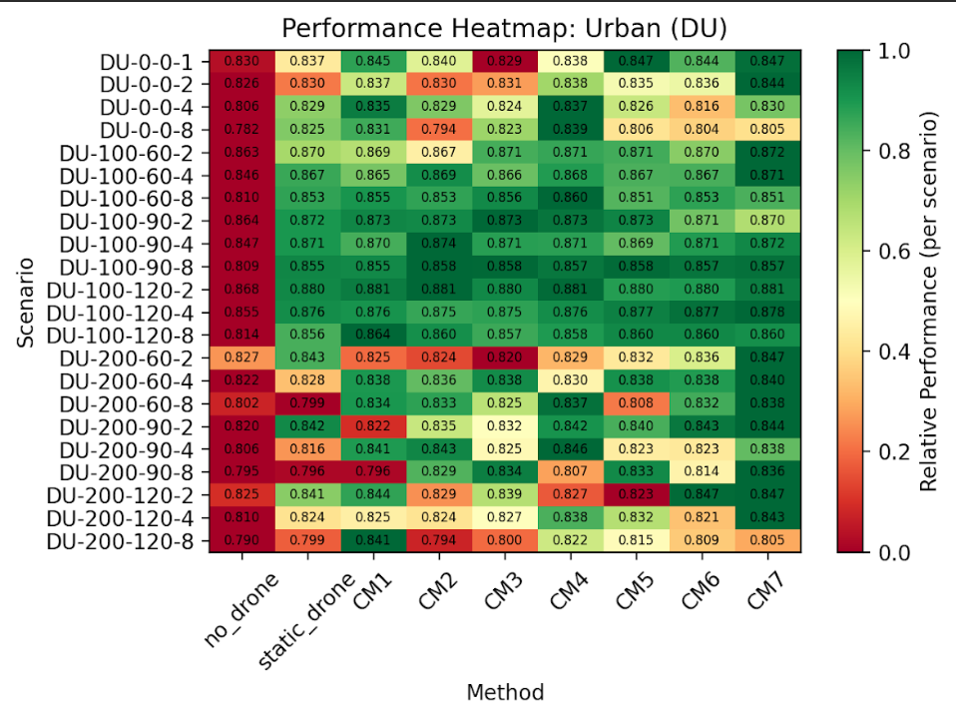

Slide 13
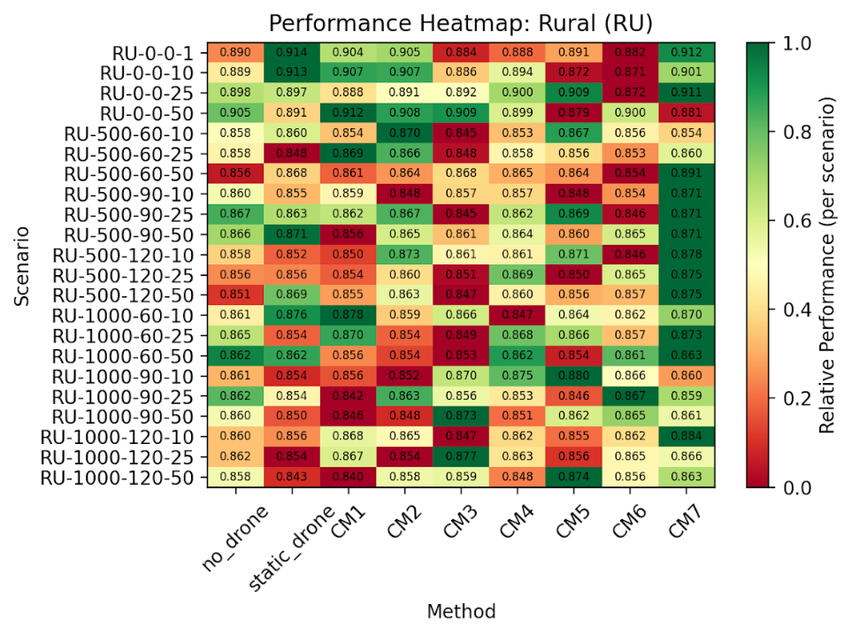

Slide 14
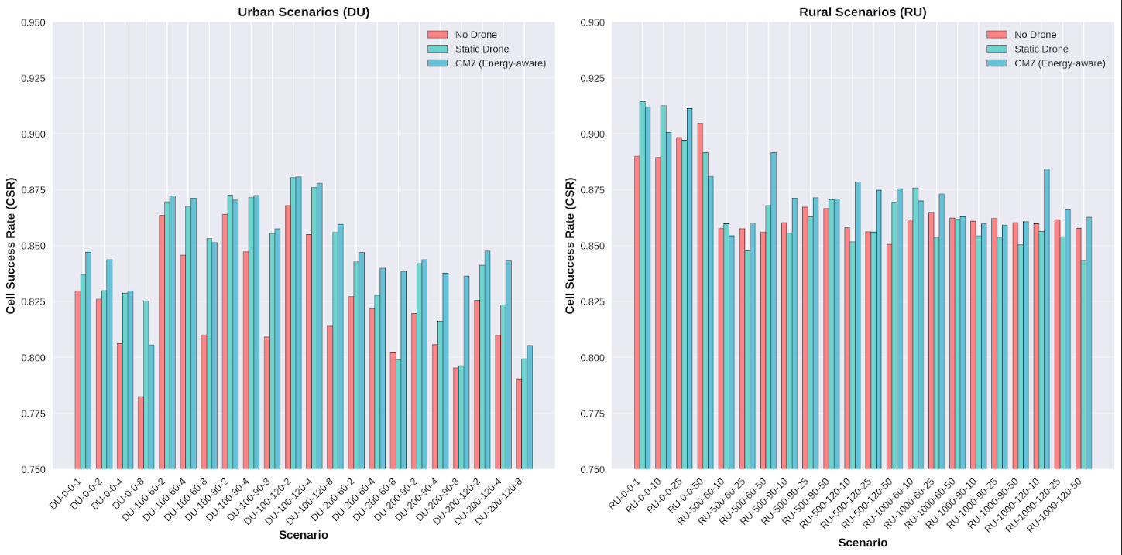

Slide 15
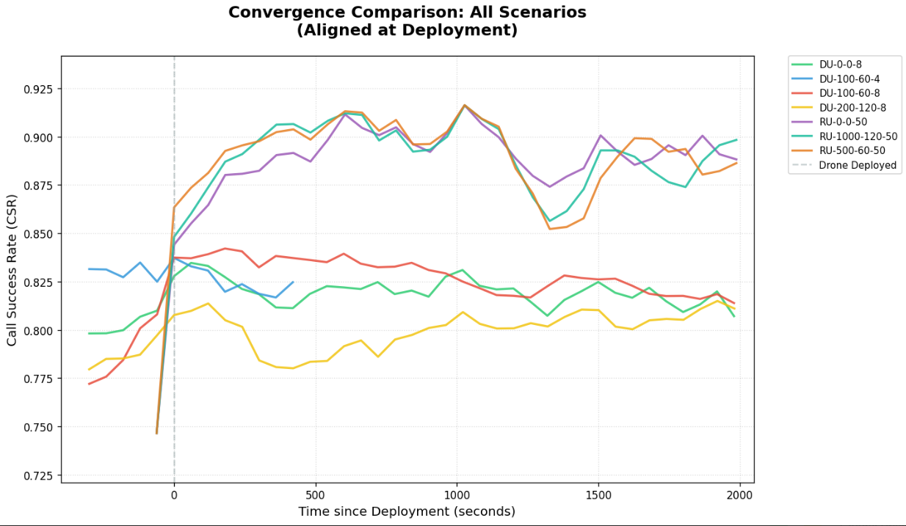

Slide 16
LIMITATIONS
The base paper does not account for energy-related constraints of the UAV, implicitly assuming unlimited battery capacity and neglecting the impact of movement on energy consumption. It focuses solely on optimizing network performance without considering the trade-off between performance gains and the energy cost of repositioning the drone. Continuous movement of the UAV is allowed without any penalty, which is unrealistic given that propulsion is one of the most energy-intensive operations in UAV systems. As a result, the proposed approach may lead to inefficient energy usage and reduced operational feasibility in real-world deployments.

Slide 17
ENERGY MODEL
The proposed system uses a simplified discrete energy model to enable real-time decision-making. Energy consumption is calculated per time step, where the UAV consumes a fixed amount of energy α when it moves and a smaller amount β when it hovers. This model does not account for factors such as velocity, acceleration, altitude changes, or aerodynamic effects, and focuses only on propulsion energy while ignoring communication-related energy consumption. Although this is a simplified approximation, it significantly reduces computational complexity and allows the UAV to make fast energy-aware positioning decisions in dynamic environments.

Slide 18
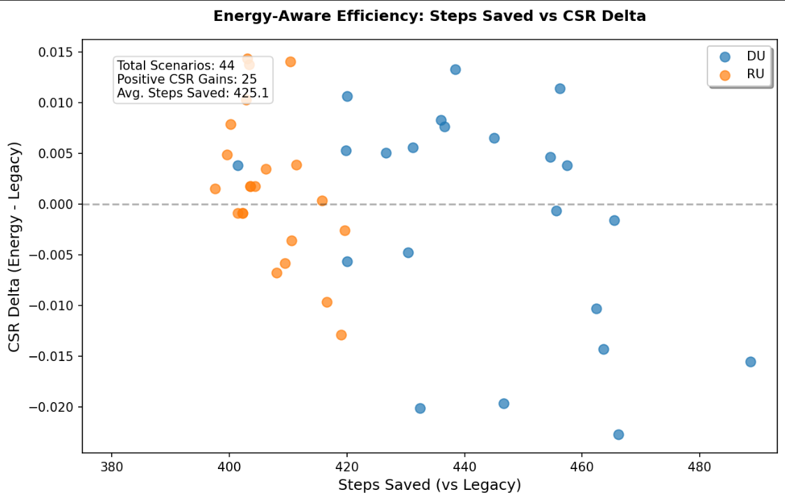

Slide 19
Key Observations & Insights
Significant Reduction in Movement
Approximately 425 fewer movement steps on average
Consistent improvement observed across all 44 scenarios
Impact on Network Performance (CSR)
Majority of scenarios exhibit negligible change in CSR
25 scenarios show improvement in CSR
Worst-case degradation remains limited (≈ −0.02)
Performance–Energy Trade-off
Substantial reduction in movement achieved with minimal performance loss
In several cases, reduced movement leads to improved stability and better CSR
Scenario-Specific Behavior
Urban (DU): Higher variability; slight performance drop in high-saving cases
Rural (RU): More stable performance; CSR changes remain close to zero

Slide 20
CONCLUSION
The energy-aware positioning algorithm delivers significant efficiency gains by reducing unnecessary UAV movement while maintaining near-equivalent network performance. In several scenarios, it even achieves improved performance, demonstrating the practical benefits of incorporating energy awareness into real-time positioning decisions. Despite its simplified design, the approach produces meaningful and reliable results, making it suitable for real-world deployment. Furthermore, there is considerable scope for future work, including the integration of more realistic UAV energy and mechanical models, as well as extending the framework to support coordinated multi-UAV networks for enhanced scalability and performance.

Slide 21
References
T. R. Pijnappel, J. L. van den Berg, S. C. Borst and R. Litjens, "Online Positioning of a Drone-Mounted Base Station in Emergency Scenarios," in IEEE Transactions on Vehicular Technology, vol. 73, no. 4, pp. 5572-5586, April 2024, doi: 10.1109/TVT.2023.3329960
Energy-aware Relay Positioning in Flying Networks
A survey on UAV assisted wireless communications: Recent advances and future trends

Slide 22
THANK YOU

